Slide 1
PHISHING WEBSITE DETECTION by MACHINE LEARNING TECHNIQUES
Phish Guard Team

Slide 2
INTRODUCTION
Phishing is the most prevalent social engineering and cyber attack.
Phishers deceive unsuspecting online users into disclosing confidential information, which is then used fraudulently.
To avoid falling victim to phishing:
Users must be aware of phishing websites.
Maintain a blacklist of phishing websites, requiring knowledge of websites identified as phishing threats.
Employ machine learning and deep neural network algorithms to detect phishing sites early.
Among these methods, machine learning-based detection is the most effective.
Despite these measures, many online users still fall prey to phishing scams, revealing sensitive information.

Slide 3
OBJECTIVES
A phishing website is a prevalent social engineering tactic that imitates trusted URLs and webpages. This project's objective is to train machine learning models and deep neural networks on a curated dataset to predict phishing websites accurately. By collecting both phishing and benign URLs, we extract essential URL and content-based features to build a comprehensive dataset. The performance of each model is then meticulously measured and compared, showcasing the effectiveness of our predictive approach.

Slide 4
APPROACH
Below mentioned are the steps involved in the completion of this project:
Collect dataset containing phishing and legitimate websites from the open source platforms.
Write a code to extract the required features from the URL database.
Analyze and preprocess the dataset by using EDA techniques.
Divide the dataset into training and testing sets.
Run selected machine learning and deep neural network algorithms like SVM, Random Forest, Auto encoder on the dataset.
Write a code for displaying the evaluation result considering accuracy metrics.
Compare the obtained results for trained models and specify which is better.

Slide 5
DATA COLLECTION
Legitimate URLs are collected from the dataset provided by University of New Brunswick, https://www.unb.ca/cic/datasets/url-2016.html.
From the collection, 5000 URLs are randomly picked.
Phishing URLs are collected from open source service called Phish Tank . This service provide a set of phishing URLs in multiple formats like csv, json etc. that gets updated hourly.
Form the obtained collection, 5000 URLs are randomly picked.

Slide 6
FEATURE SELECTION
The following category of features are selected:
• Address Bar based Features
• Domain based Features
• HTML & JavaScript based Feature
Address Bar based Features considered are:
• Domain of URL • Redirection ‘//’ in URL
• IP Address in URL • ‘http/https’ in Domain name
• ‘@’ Symbol in URL • Using URL Shortening Service
• Length of URL • Prefix or Suffix "-" in Domain
• Depth of UR

Slide 7
FEATURE SELECTION (CONT.)
Domain based Features considered are:
• DNS Record • Age of Domain
• Website Traffic • End Period of Domain
• HTML and JavaScript based Features considered are:
All together 17 features are extracted from the dataset.

Slide 8
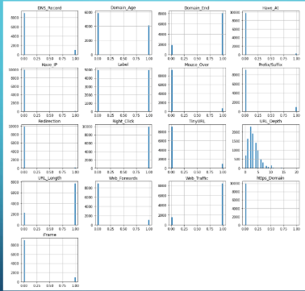
FEATURES DISTRIBUTION

Slide 9
MACHINE LEARNING MODELS
• This is a supervised machine learning task. There are two major types of supervised machine learning problems, called classification and regression.
• This data set comes under classification problem, as the input URL is classified as phishing (1) or legitimate (0). The machine learning models (classification) considered to train the dataset in this notebook are:
• Decision Tree
• Random Forest
• Multilayer Perceptron's
• XGBoost
Autoencoder Neural Network
• Support Vector Machines

Slide 10
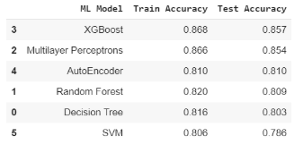
MODEL EVALUATION
The models are evaluated, and the considered metric is accuracy.
Below Figure shows the training and test dataset accuracy by the respective models:
For the above it is clear that the XGBoost model gives better performance. The model is saved for further usage.

Slide 11
NEXT STEPS
Working on this project is highly educational and rewarding.
It provides in-depth knowledge about phishing websites and their differentiation from legitimate ones.
The project can be advanced by developing browser extensions or creating a GUI.
These tools should classify inputted URLs as legitimate or phishing using the trained model.

Slide 12
Thank You…..

